Slide 1
Phishing websites detection
By Preet Kaur

Slide 2
Outline
Introduction
Motivation
Literature Review
Problem Definition
Models used in the project
Experiment Results and Evaluation
Conclusion and limitations.
Future Work
References

Slide 3


What is phishing?
Phishing is the most commonly used by social engineering and cyber attack.
Phishing attack is a simple and effective way to steal sensitive information from users.
In order to avoid getting phished
Users should have awareness of phishing websites
Detect them in the early appearance, using machine learning and deep neural network algorithm

Slide 4
Motivation
Motivation for this project is to check if the URL’s are legitimate or phishing/spam. Phishing is a type of attack that occurs when a website looks very close to a legitimate website. Usually, the attacker creates a fake website in order to trick users.
For example –
salemstate.edu
salemstate.us.edu

Slide 5
Machine learning Models
Naïve Bayes
Support Vector Machine
K Nearest Neighbor

Slide 6

HOW DID WE USE MODELS.
We used 3 models and Our goal for using these machine learning to detect phishing URL’s and find the target. we used it to compare the accuracy rate, false positive and negative rate of various algorithms.

Slide 7

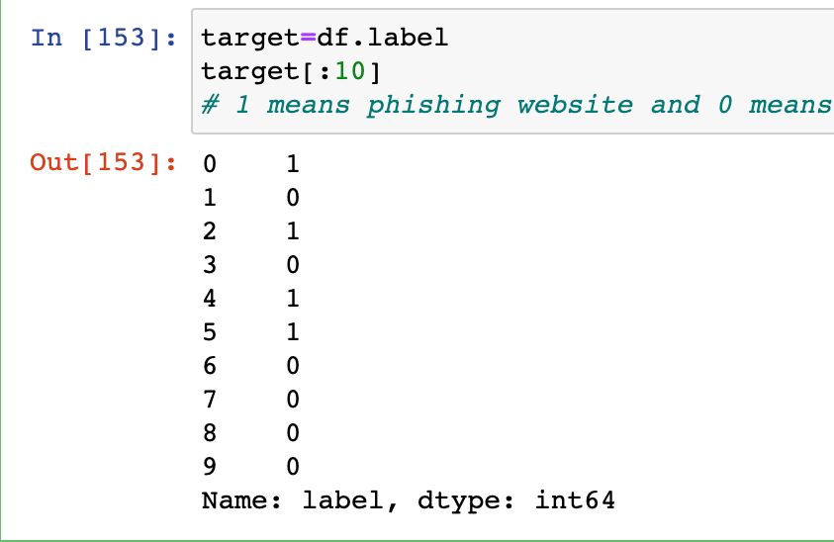
The problem we solved
We used two Salem state domain links to check which one is fake or real site. And based on my results the real site gave results as a 0 and fake as a 1.

Slide 8
Literature review
Although there are many methods to detect phishing websites, most of them fail due to the complexity of the attacks . One of the affective model was is naïve bayes.
Phishing can be eradicated, however by improving the techniques and procedure can detect and prevent fraudulent websites.

Slide 9
Questions
Simple question
How many features will be used?
We have 12 features, but we used 5 to get the results
Advanced question
See who is the target either based on active duration or label ?
Based on plotting and heat map it shows that the Label is the target and how features are related to each other.
Predicating of phishing URLs by extracting and analyzing various features of legitimate and phishing URLs.
2 Salem sites website one will be used as a spam and other one will be legitimate. We will check the prediction and find the results

Slide 10
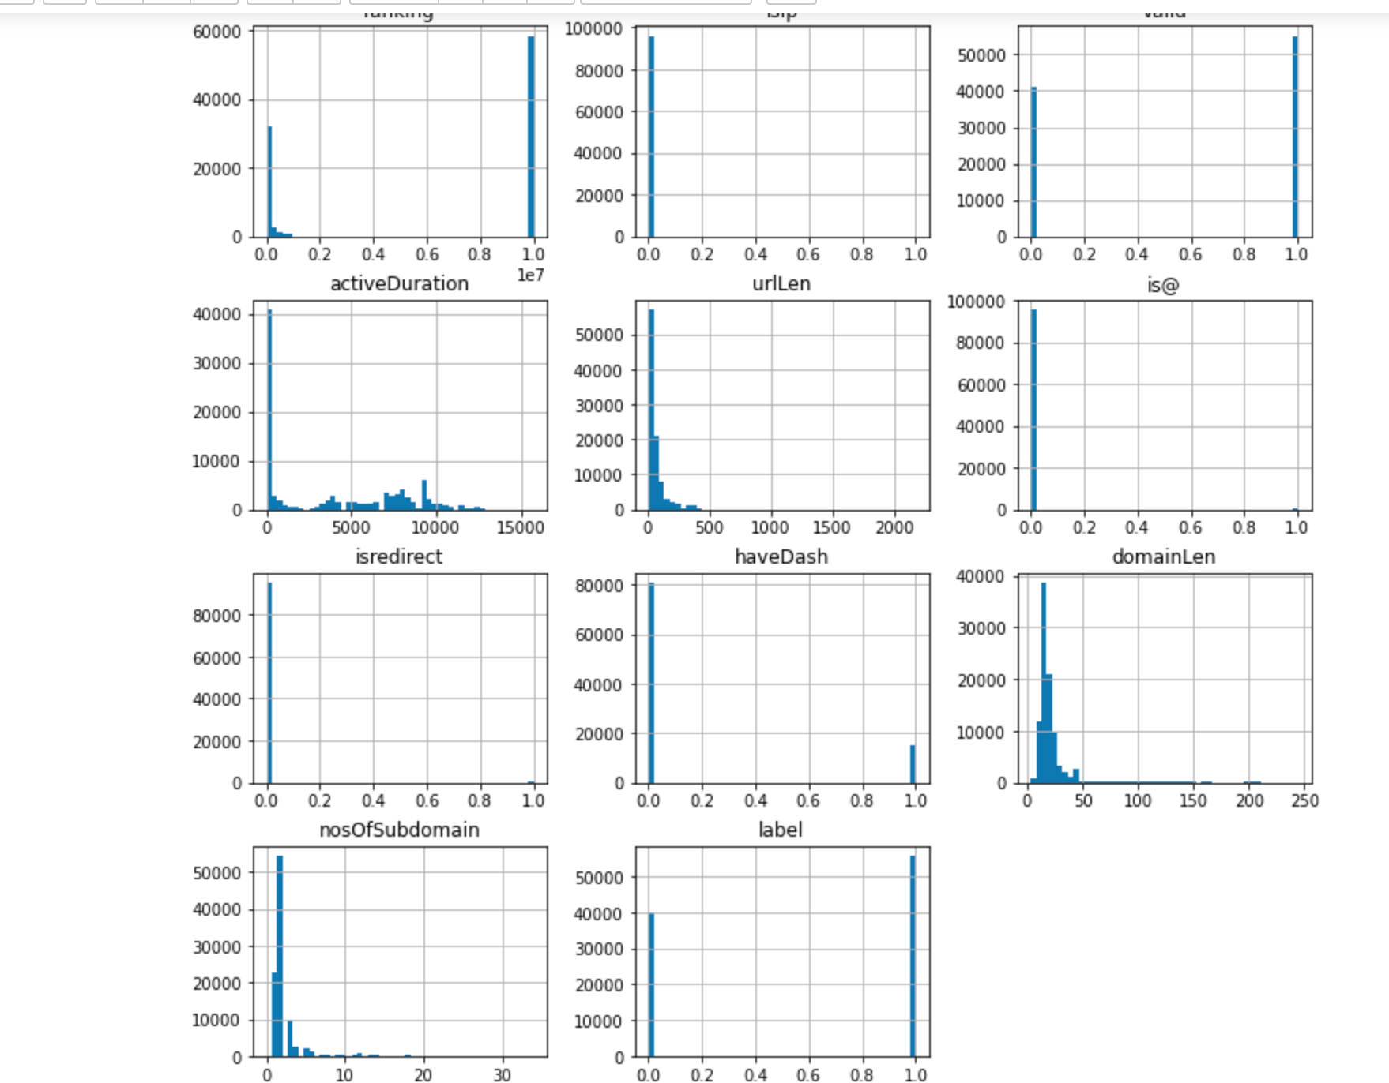
Feature selection and Plots
Features selection
Domain, ranking, isIP, valid, urLen, is@, IsDirect, haveDash, domainLen, noofSubdomain, labels
Theses plots and graphs are displayed to find how the data is distributed and the how features are related to each other.

Slide 11
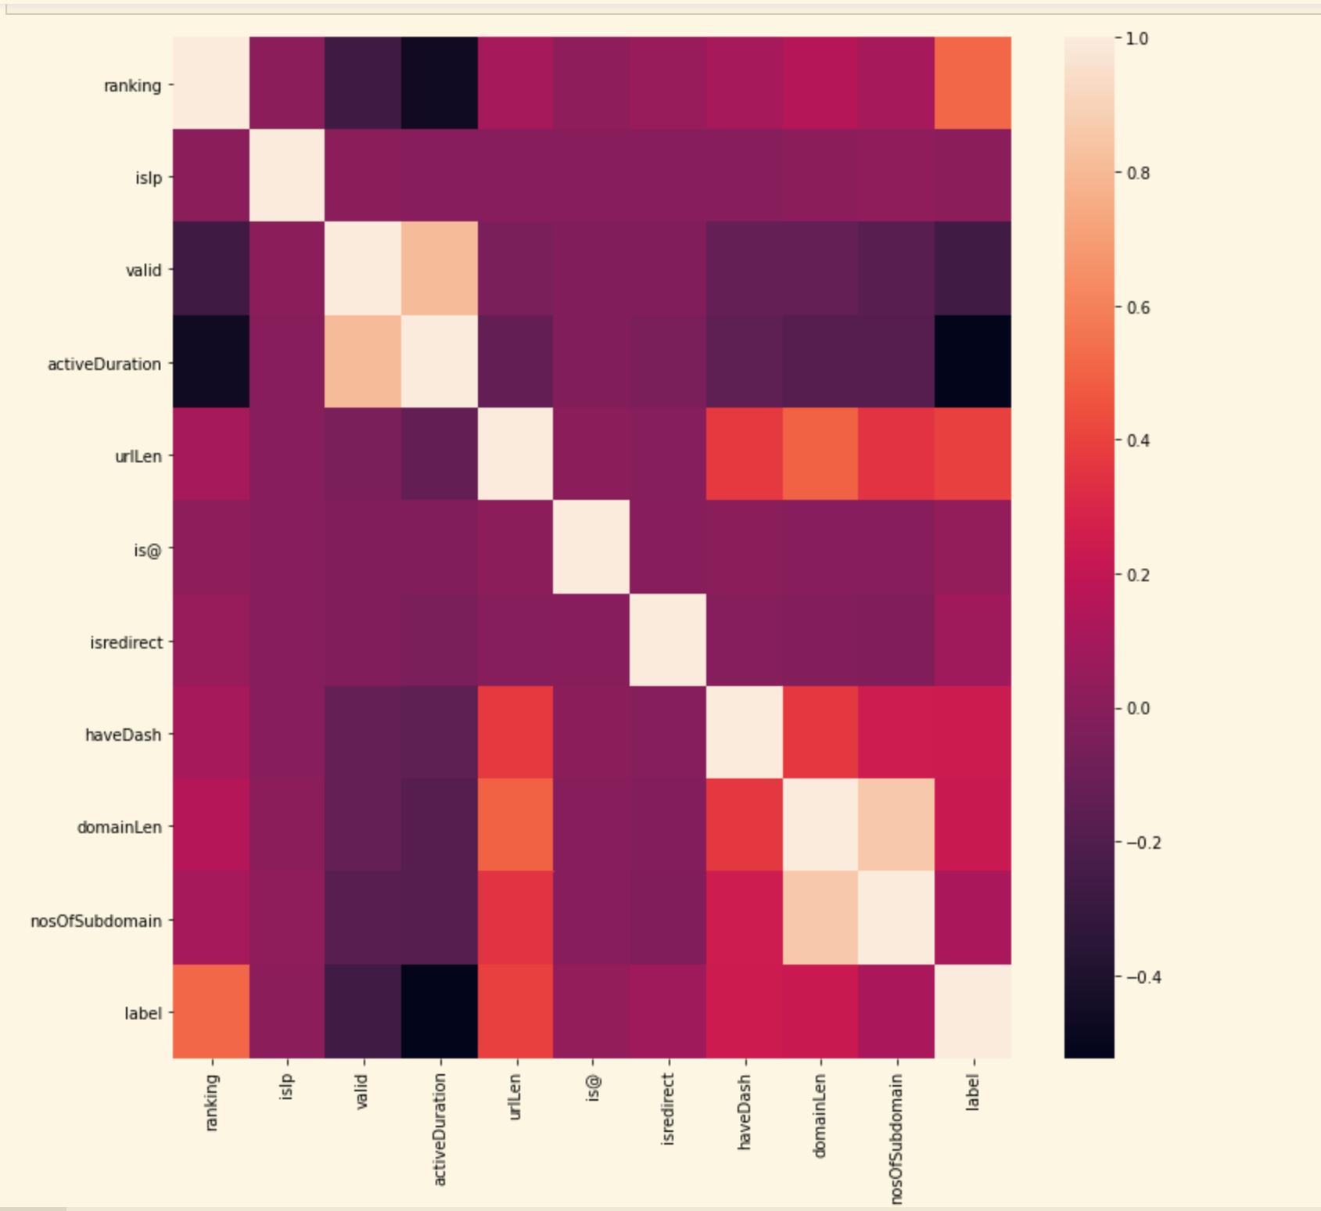
Heat map

Slide 12
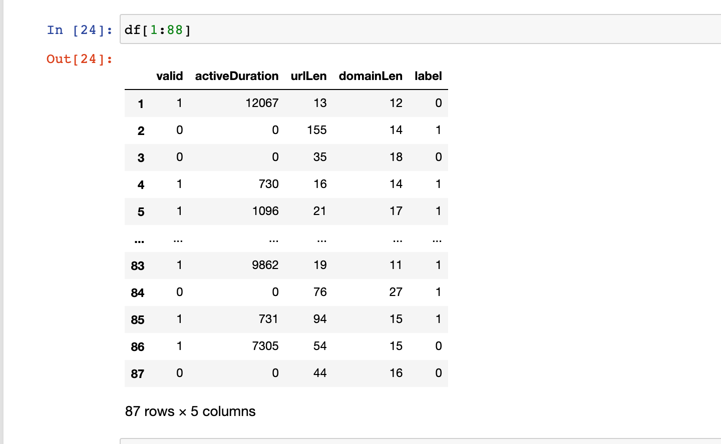
Advance question answer

Slide 13

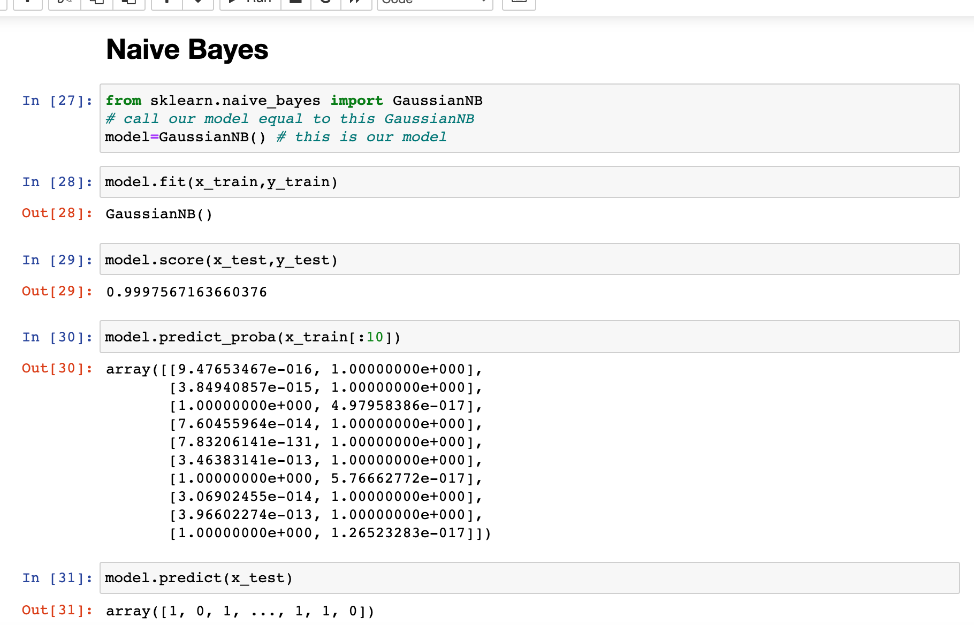
Models , EXPERIMENTS AND EVALUATION 1. naïve bayes

Slide 14
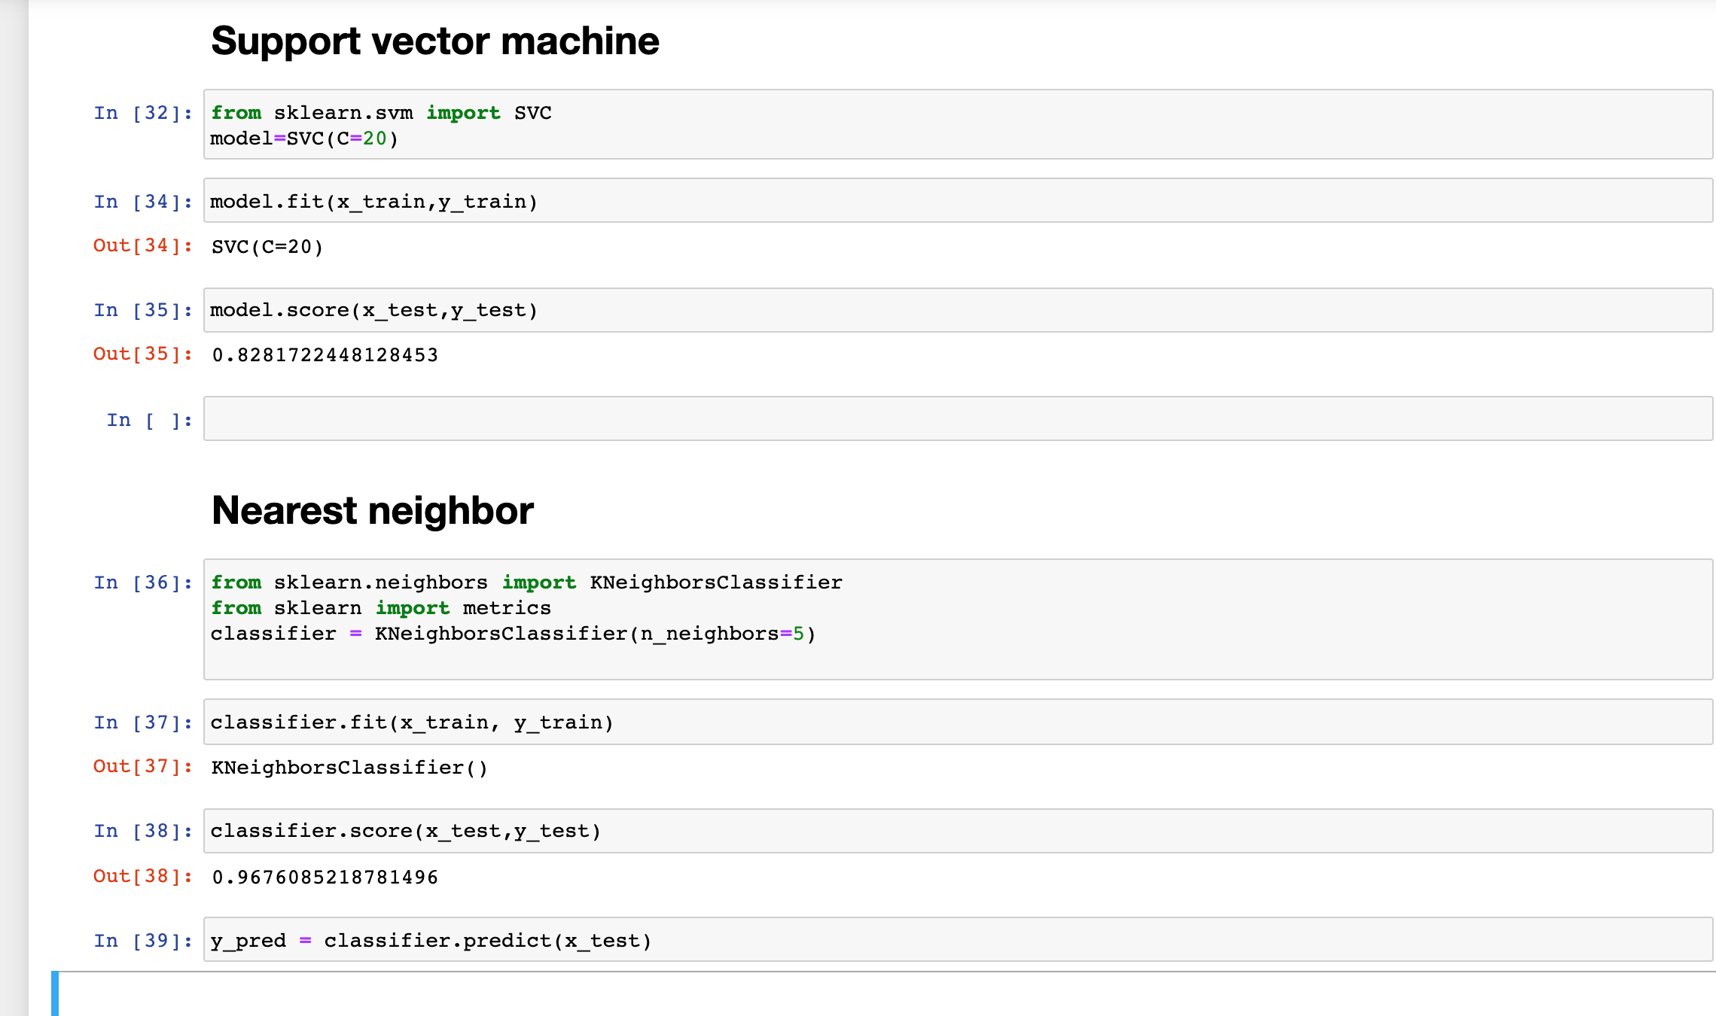
2. sVM, 3. K-NEAREST NEIGHBOR

Slide 15

CONCLUSION/LIMITATION
Phishing can be eradicated, however by improving the techniques and procedure can detect and prevent fraudulent websites. The aims to provide an overview of the various anti-phishing techniques that can be used to prevent phishing attacks.
The limitation of this technique is that detection of zero- hour phishing attacks is not possible. In this technique the legitimate URLs are stored in the database and are used for checking new URLs.

Slide 16
Future work
This project can be further extended to creation of browser extension
Or .
To create a GUI project so we can easily detect phishing websites.
. I would like to add different models and see the end results.

Slide 17

References
https://arxiv.org/pdf/2009.11116.pdf#:~:text=Multiple%20machine%20learning%20methods%20have,described%20in%20the%20following%20section.
https://journals.plos.org/plosone/article?id=10.1371/journal.pone.0258361
https://scialert.net/fulltext/?doi=itj.2012.921.925
https://www.hindawi.com/journals/wcmc/2018/4678746/#related-works

Slide 18
Thank you!

